Slide 1
MY POWERPOINT FOR COMPUTER NETWORK
安希佐 4110E229 My Dear Great Teacher

Slide 2
AGENDA
Computer network
WAN,MAN,LAN,PAN
Hardware
Network connecting devices
Network topology
Software
OSI MODEL
TCP/IP protocol
Windows Networking Commands
For more info: SLIDESGO | SLIDESGO SCHOOL | FAQs
You can visit our sister projects: FREEPIK | FLATICON | STORYSET | WEPIK | VIDEVO

Slide 3
Goals of networks
Computer networks have a number of significant objectives, some of which are listed below:Resource sharing - Many businesses use numerous computers scattered across their operations. Ex. Shared office equipment like a printer, fax machine, modem, scanner, etc.High Reliability - All files could be copied on two or more machines if there were alternative sources of supply. The other copies could be used if one of them is unavailable due to hardware failure.Inter-process Communication: Through the network, individuals who are geographically separated from one another can engage in an interactive session. The network must provide nearly error-free communications for this to be possible.
For more info: SLIDESGO | SLIDESGO SCHOOL | FAQs
You can visit our sister projects: FREEPIK | FLATICON | STORYSET | WEPIK | VIDEVO

Slide 4
Computer network

Slide 5
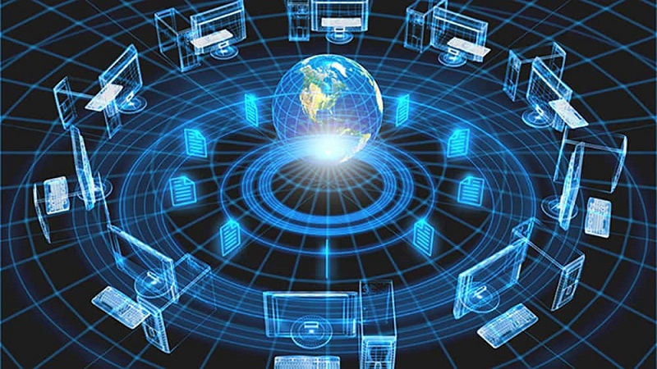
COMPUTER NETWORK
About us
03
Our services
04
You can describe the topic of the section here
You can describe the topic of the section here

Slide 6
Computer networking refers to interconnected computing devices that can exchange data and share resources with each other. These interconnections are made up of telecommunication network technologies

Slide 7
01
Wide-Area Network?

Slide 8
WAN (Wide-Area Network)
A wide-area network is a type of computer network that spans a relatively large geographical area. A wan typically consists of two or more local-area networks (LANS).

Slide 9
02
MAN/ Metropolitan Area Network?

Slide 10
Metropolitan Area Network / man

Slide 11
Metropolitan Area Network (MAN)
MAN or Metropolitan area Network covers a larger area than that of a LAN and smaller area as compared to WAN. It links two or more distant computers that may be located in the same city or in other cities. It has a wide geographic scope and could be an ISP (Internet Service Provider). Customers who require high-speed connectivity can use MAN. MAN speeds vary in units of Mbps. Designing and maintaining a metropolitan area network is challenging.

Slide 12
03
LAN/ Local Area Network?

Slide 13
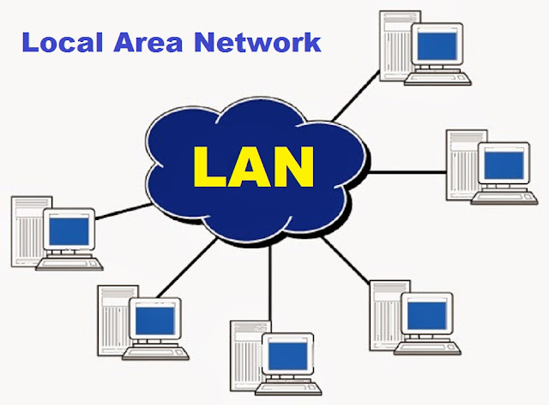

Slide 14
The LAN, or local area network, links network components so that workstations and personal computers can exchange information, resources, and software. The TCP/IP protocol's private addressing scheme is used to connect the collection of computers and devices together via a switch or stack of switches. On the local network, private addresses are distinct from those of other computers. At the edge of a LAN, routers are located, linking them to the broader WAN.Due to the small number of connected computers, data transfers relatively quickly. The connections must by definition be made using reasonably cheap and fast technology (Such as hubs, network adapters, and Ethernet cables). LANs only reach a few locations due to their tiny size.
Local Area Network (LAN)

Slide 15
04
PAN/ Personal Area Network?

Slide 16
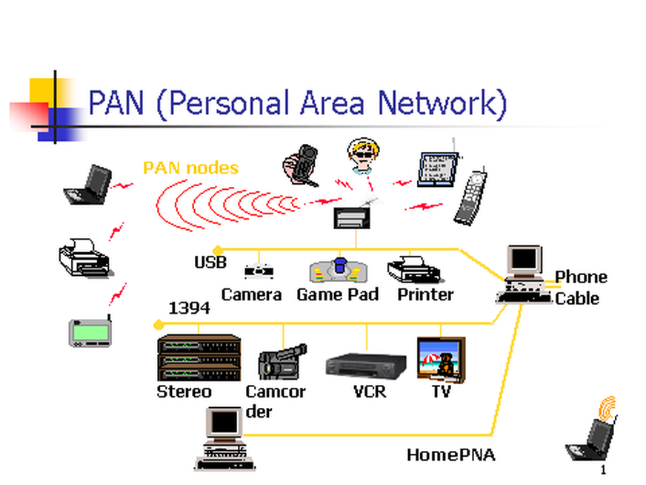

Slide 17
Personal Area Network (PAN)
A person's personal area network (PAN) is a computer network that links any computers or other devices that are located in their immediate vicinity. PAN, which normally delivers network coverage within a person's range of 10 meters (33 feet), is known as a personal area network. A personal area network often consists of a computer, phone, tablet, printer, PDA, and additional electronics for entertainment such as speakers, video game consoles, etc.PAN was created for the first time by Thomas Zimmerman and other researchers at M.I.T.'s Media Lab. Due to its excellent flexibility and efficiency, it is highly helpful in homes, offices, and small network regions.

Slide 18
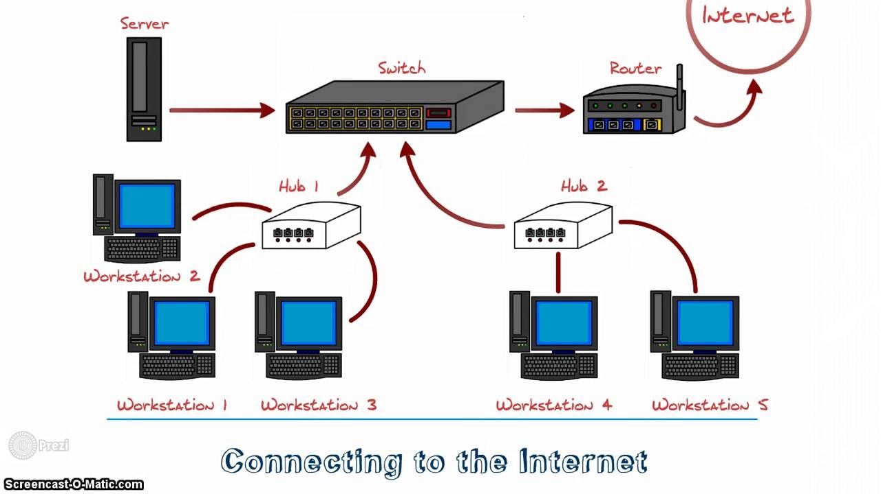
Networking hardware is the individual components of a network system that are responsible for transmitting data and facilitating the operations of a computer network. Although a network contains many hardware components, there are several basic categories that make up the complete operations of a network system. Here are some of the different categories and how they contribute as a whole to the overall functioning of a network system.
Hardware

Slide 19
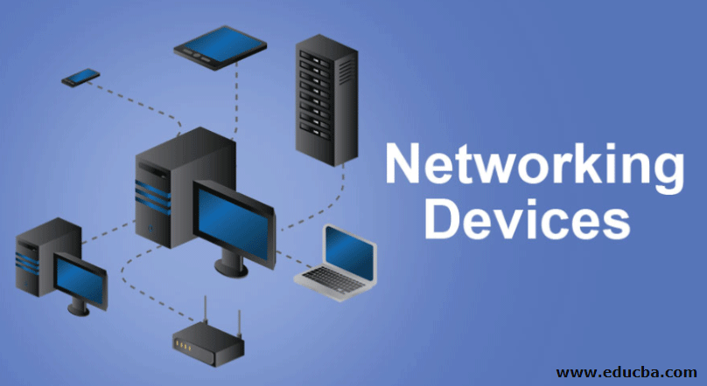
Network devices and Hardware

Slide 20
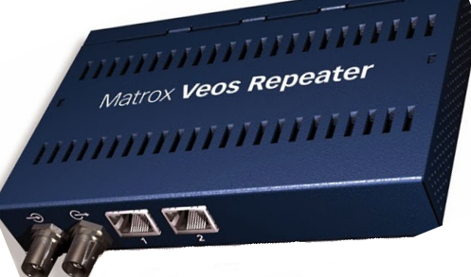
Repeaters
Repeaters are network devices that amplify or regenerate an incoming signal before retransmitting it at the physical layer of the OSI model. They are used in networks to increase their coverage area. Signal boosters are another name for them.

Slide 21
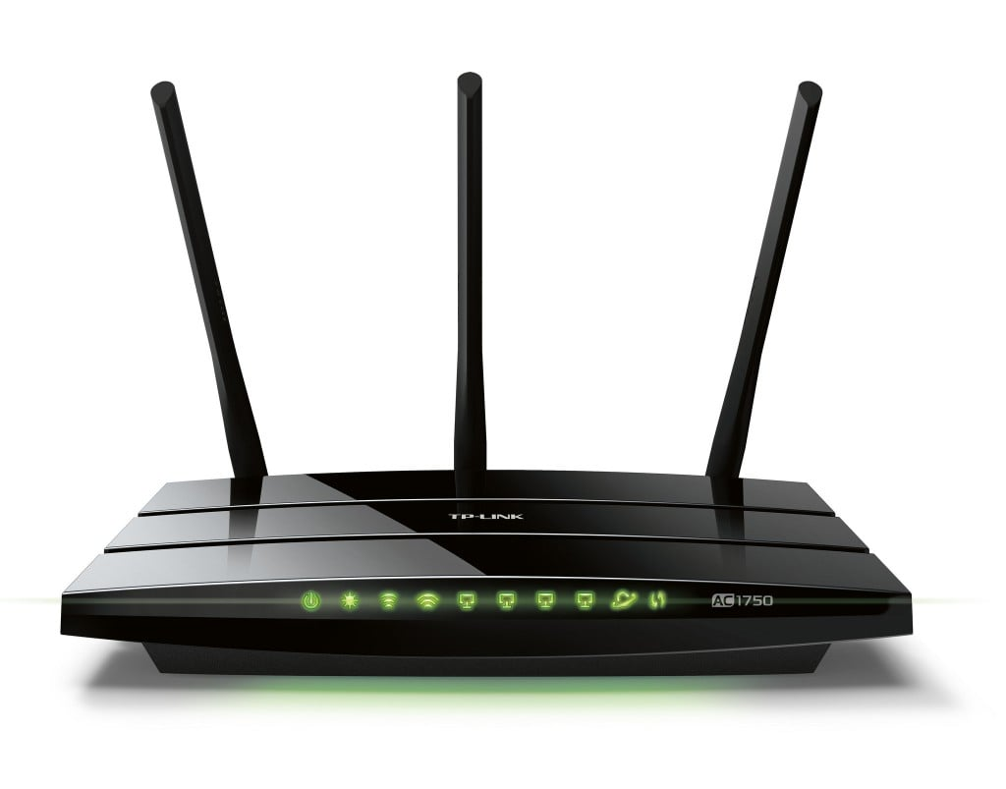
MODEM
A modem makes it possible for a computer to access the internet over a phone connection. The modem at one end transforms the digital impulses from the computer into analog signals and transmits them via a phone line. On the other end, it transforms the analog signals into digital signals that a different computer can understand.

Slide 22
hubs
A network hub is a node that broadcasts data to all computers and Ethernet-connected devices that are linked to it. A hub lacks the sophistication of a switch, which may isolate data streams to specific devices.Network hubs are best suited for small, straightforward LAN settings. Hubs are unable to perform routing or other complex network services. Network hubs are commonly referred to as "dumb switches" since they operate by indiscriminately forwarding packets across all ports.

Slide 23
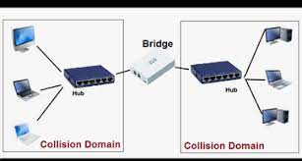
bridges
Two different LAN networks are linked by a bridge. Before sending a message, it searches for the receiving device. This suggests that it prevents pointless data transfers in the absence of a receiving device. Additionally, it confirms that the recipient device has not already received the message. The network performs better as a whole thanks to these techniques.

Slide 24
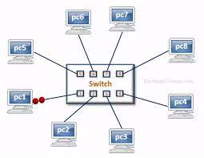
switch
A switch serves the same purpose as a hub or a bridge but is more powerful. It keeps track of the MAC addresses of network devices and only sends data packets to those that have asked for them. As a result, a switch becomes more effective when there is a strong demand since the latency is decreased.

Slide 25
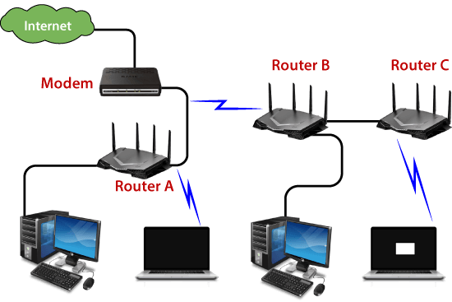
routers
Two or more networks are connected by a router. The router is frequently used to link a LAN (local area network) in a house or office to the internet (WAN). In addition to connections connecting computers on the LAN, it typically includes an internet cable plugged in. As an alternative, a network device can have a wireless (Wi-Fi-enabled) LAN connection. Additionally known as wireless access points, these (WAPs).

Slide 26
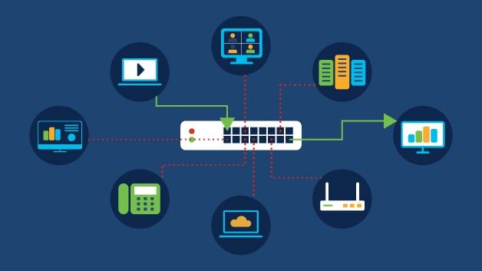
GATEWAY
Two or more networks are connected by a router. The router is frequently used to link a LAN (local area network) in a house or office to the internet (WAN). In addition to connections connecting computers on the LAN, it typically includes an internet cable plugged in. As an alternative, a network device can have a wireless (Wi-Fi-enabled) LAN connection. Additionally known as wireless access points, these (WAPs).

Slide 27
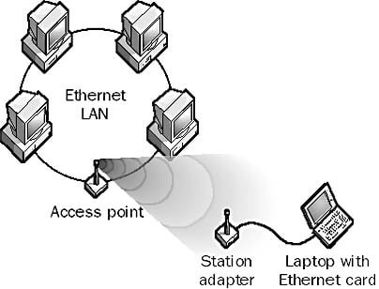
Access point
A wireless access point (WAP), sometimes known as an access point (AP), is a networking hardware device that connects other Wi-Fi devices to a wired network. The AP may have a physical connection to a router as a standalone device, but with a wireless router, it may also be an integral component of the router itself. An AP is distinct from a hotspot, which is a physical location with Wi-Fi connection.

Slide 28
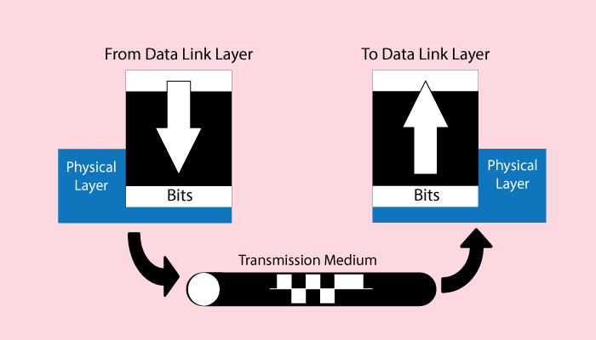
L1/ PHYSICAL LAYER
The Physical Layer is in charge of sending and receiving unstructured raw data between a device such a network interface controller, Ethernet hub, or network switch and a physical transmission media. It is responsible for converting digital information into electrical, radio, or optical signals. Layer requirements define voltage levels, voltage change timing, physical data rates, maximum transmission distances, modulation system, channel access method, and physical connectors. For wireless devices, this comprises pin layout, voltages, line impedance, cable specs, signal timing, and frequency.

Slide 29
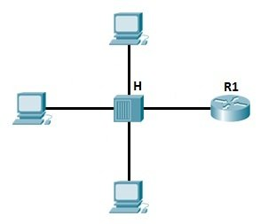
L2/ PHYSICAL LAYER
A layer 2 switch is a network switch or device that operates at the data link layer (OSI Layer 2) and uses MAC addresses to determine the path through which frames are to be forwarded. It connects and transmits data in a local area network using hardware-based switching techniques (LAN).

Slide 30
Media Access Control
A media access control (MAC) is a network data transfer policy that controls how data is sent over a network cable between two computer terminals. Sublayers of the data link layer 2 in the OSI reference model are involved in the media access control policy.The main goal of the MAC protocol is to prevent collisions while facilitating data packet transfers between two computer terminals. When two or more terminals communicate data or information at the same time, a collision occurs. As a result, communication breaks down, which can be expensive for businesses that depend heavily on data transmission.
L2/ PHYSICAL LAYER

Slide 31
LOGICAL LINK Control
The logical link control (LLC) data communication protocol layer is the highest sublayer of the data link layer (layer 2) of the seven-layer OSI model in the IEEE 802 reference model of computer networking. The LLC sublayer serves as an interface between the MAC sublayer and the network layer.The LLC sublayer provides multiplexing methods that allow several network protocols (for example, IP, IPX, and DECnet) to coexist inside a multipoint network and be carried over the same network media. It can also provide flow control and fault management techniques for automatic repetition request (ARQ).
L2/ PHYSICAL LAYER

Slide 32
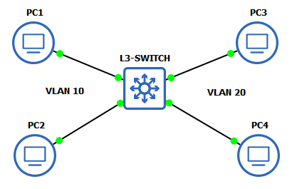
L3/ LAYER 3 SWITCH
A Layer 3 switch is basically a switch that can perform routing functions in addition to switching. A client computer requires a default gateway for layer 3 connectivity to remote subnets.

Slide 33
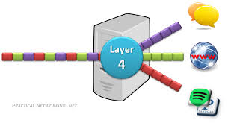
L4/ LAYER 4 SWITCH
The transport layer, or Layer 4 of the OSI model, handles network traffic between hosts and end systems to enable complete data transfers. TCP, UDP, DCCP, and SCTP are transport-layer protocols that manage the volume of data, where it is transmitted, and at what pace it is sent.
Layer 4 avoids the requirement for the application-oriented layers 5 - 7 to consider the features of the communications network itself by providing standardized access to communication services such as connection-oriented communication, reliability, flow control, and multiplexing. Layer 4 is also in charge of error recovery from beginning to conclusion.

Slide 34
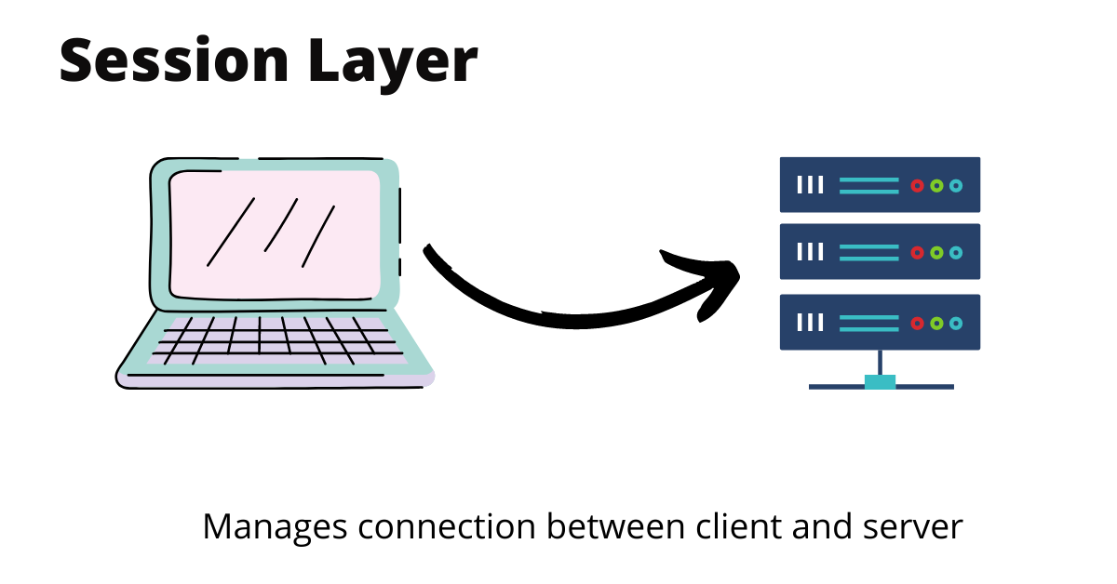
L5/ SESSION LAYER
The Session Layer sets the setup, regulates the connections, and finishes the takedown of a "session" between two or more computers. Because DNS and other Name Resolution Protocols operate in this tier, frequent Session Layer functions include user logon (establishment), name lookup (management), and user logoff (termination). Authentication protocols, for example, are embedded into most client software, such as the FTP Client and NFS Client for Microsoft Networks. As a result, the Session layer creates, manages, and terminates connections between local and distant applications.

Slide 35
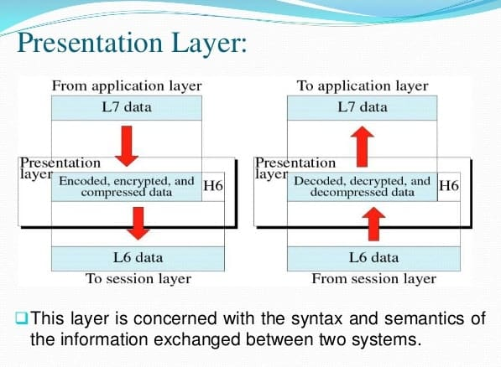
L6/ PRESENTATION LAYER
The Presentation Layer handles protocol conversion, data encryption, data decryption, data compression, data decompression, data representation incompatibility between operating systems, and graphic commands. The presentation layer converts data so that it can be sent across a network in the form that the application layer accepts. Because the Presentation Layer translates data and visuals into a display format for the Application Layer, it is also known as the Syntax Layer. As a result, the Presentation Layer negotiates the transfer of syntax structure via the Abstract Syntax Notation One (ASN.1) Basic Encoding Rules, with capabilities such as converting an EBCDIC-coded text file to an ASCII-coded file, or serialization of objects and other data structures from and to XML.

Slide 36
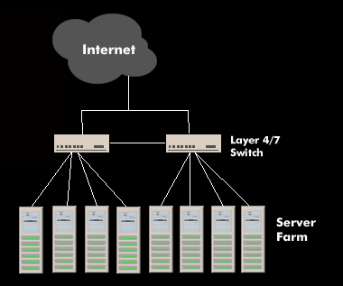
L7/ LAYER 7 SWITCH
A Layer 7 switch is a network device that combines routing and switching functions. It can pass traffic and perform forwarding and routing choices at Layer 2 speed, but it relies on information from the application layer or Layer 7.Layer 7 switches are also known as Layer 4-7 switches, content switches, content service switches, Web switches, and application switches.

Slide 37
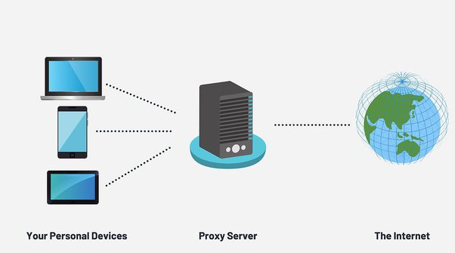
proxy
Two or more networks are connected by a router. The router is frequently used to link a LAN (local area network) in a house or office to the internet (WAN). In addition to connections connecting computers on the LAN, it typically includes an internet cable plugged in. As an alternative, a network device can have a wireless (Wi-Fi-enabled) LAN connection. Additionally known as wireless access points, these (WAPs).

Slide 38
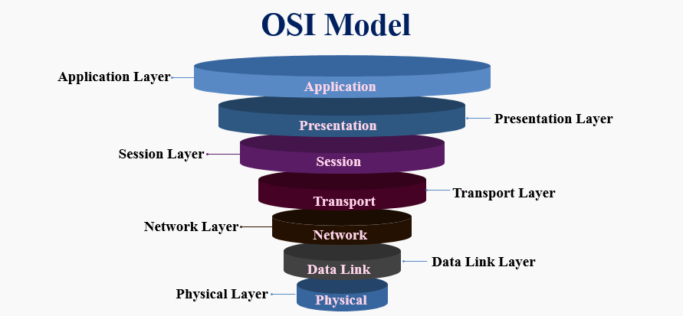
OSI MODEL
OSI model stands for Open System interconnection mode developed by the international organization for standardization in 1984, designed to show the flow of moving data from one software application of one computer to another software application of another computer. It consists of seven layers – Physical layer, Data link layer, Network layer, Transport layer, Session layer, Presentation layer and Application layer. Each layer has its own tasks, which are performed independently.

Slide 39
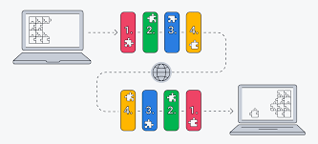
TCP/IP MODEL
What is a TCP IP model?
TCP/IP stands for Transmission Control Protocol/Internet Protocol and is a suite of communication protocols used to interconnect network devices on the internet. TCP/IP is also used as a communications protocol in a private computer network (an intranet or extranet).

Slide 40
Relation to tcp/ip model
The Internet's protocol set is described by the TCP/IP model. [3] The Internet layer is a layer in the TCP/IP paradigm that sits above the link layer. The TCP/IP Internet layer and the OSI network layer are often used interchangeably in textbooks and other secondary sources. The permissible properties of protocols (such as whether they are connection-oriented or connection-less) placed into these layers are different in the two models, therefore this comparison is inaccurate. [Reference needed] In reality, the network layer's functionality is only partially implemented at the TCP/IP Internet layer. It exclusively discusses the Internet, a single sort of network design.

Slide 41
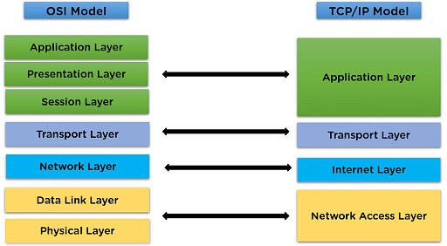
Difference between osi & tcp/ip model
TCP/IP Model is a communication protocols suite using which network devices can be connected to the Internet. On the other hand, the OSI Model is a conceptual framework using which the functioning of a network can be described.

Slide 42
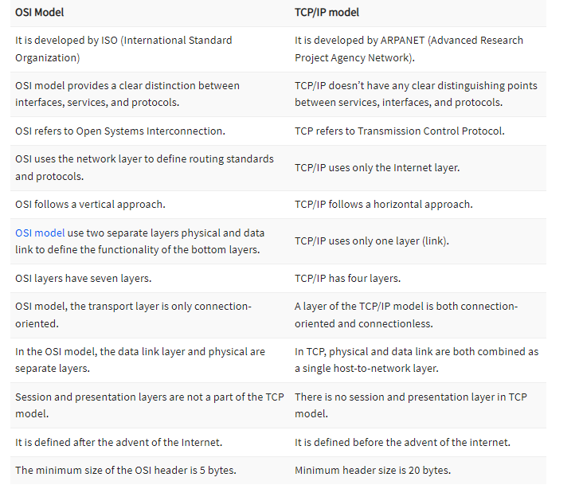
differences between the OSI and TCP/IP model:

Slide 43
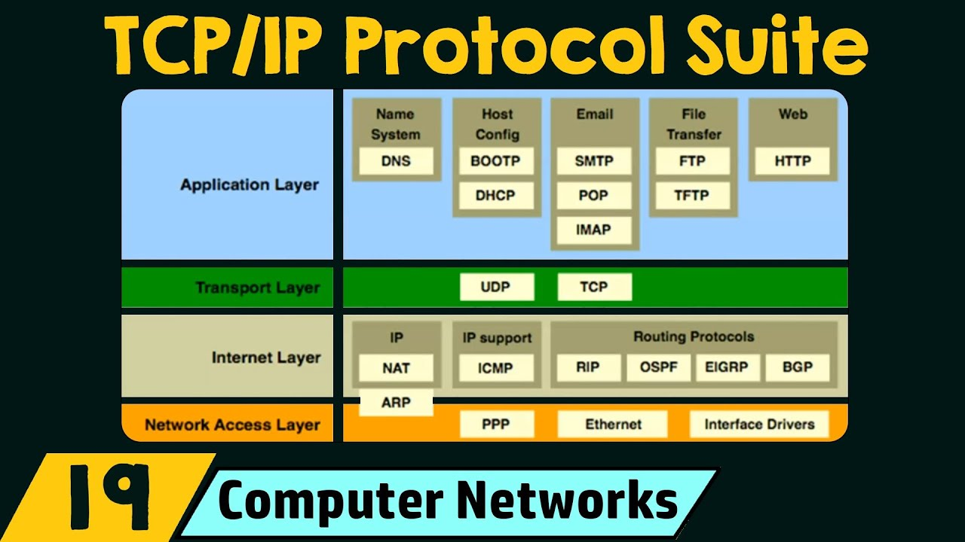
TCP/IP protocol suites
The Internet protocol suite, also referred to as TCP/IP, is a framework for categorizing the collection of communication protocols used on the Internet and other comparable computer networks. The Transmission Control Protocol (TCP), User Datagram Protocol (UDP), and Internet Protocol are the suite's fundamental protocols (IP).

Slide 44
Application layer
The protocols utilized by the majority of applications for delivering user services or exchanging application data through the network connections created by the lower level protocols are included in the application layer. This could include fundamental network support services like host configuration and routing protocols. The File Transfer Protocol (FTP), the Simple Mail Transfer Protocol (SMTP), the Dynamic Host Configuration Protocol, and the Hypertext Transfer Protocol are some examples of application layer protocols (DHCP). [36] Application layer protocols are used to encode data, which is then contained in transport layer protocol units (such as TCP streams or UDP datagrams) that use lower layer protocols to carry out the actual data transferred. The TCP/IP paradigm does not specify extra layers between protocols and does not take into account the intricacies of structuring and presenting data.

Slide 45
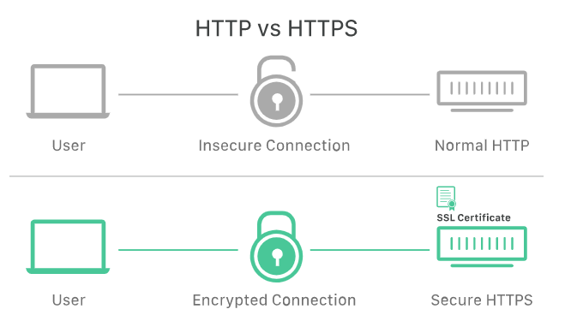

Slide 46
HTTPS VS HTTPS
HTTPS is HTTP with encryption and verification. The only difference between the two protocols is that HTTPS uses TLS (SSL) to encrypt normal HTTP requests and responses, and to digitally sign those requests and responses. As a result, HTTPS is far more secure than HTTP. A website that uses HTTP has http:// in its URL, while a website that uses HTTPS has https://.

Slide 47
Transporting Layer
The transport layer creates fundamental communication channels that programs can use to communicate task-specific data. The layer establishes host-to-host connectivity in the form of end-to-end message transfer services that are independent of the underlying network and of the structure of user data as well as the logistics of information exchange. At the transport layer, connectivity can be connection-oriented (expressed in TCP) or connectionless (implemented in UDP). This layer's protocols may offer error control, segmentation, flow management, congestion control, and application addressing (port numbers).The layer establishes the idea of the network port to provide process-specific transmission channels for applications. This is a numbered logical construct that is assigned to each of the communication channels required by an application.

Slide 48
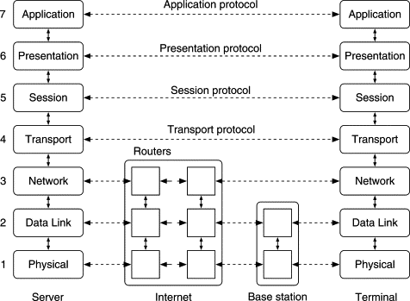
Interconnecting Layer
Internetworking is the practice of interconnecting multiple computer networks,[1]: 169 such that any pair of hosts in the connected networks can exchange messages irrespective of their hardware-level networking technology. The resulting system of interconnected networks are called an internetwork, or simply an internet.
The most notable example of internetworking is the Internet, a network of networks based on many underlying hardware technologies. The Internet is defined by a unified global addressing system, packet format, and routing methods provided by the Internet Protocol.

Slide 49

Network Topology
The arrangement of the elements (links, nodes, etc.) of a communication network is referred to as network topology. Network topology is a term that can be used to define or describe the configuration of various types of telecommunication networks, such as command and control radio networks, industrial fieldbusses, and computer networks. A network's topology is its topological structure, which can be represented physically or logically. It is a graph theory[3] application in which communicating devices are modeled as nodes and connections between the gadgets are modeled as links or lines between the nodes.

Slide 50
Basic Categories of network topologies
Physical topology refers to where different network elements are located (such as device placement and cable installation), whereas logical topology shows how data moves throughout a network. Even if two networks may have different node distances, physical connections, transmission speeds, or signal kinds, their logical topologies might be the same. The physical layer of the OSI model is particularly interested in the physical topology of a network. Local area networks (LANs), a popular type of computer network installation, contain examples of network topologies. A graphic representation of these links produces a geometric shape that may be used to represent the physical architecture of the network. Each node in the LAN has one or more physical links to other network components. a vast range

Slide 51
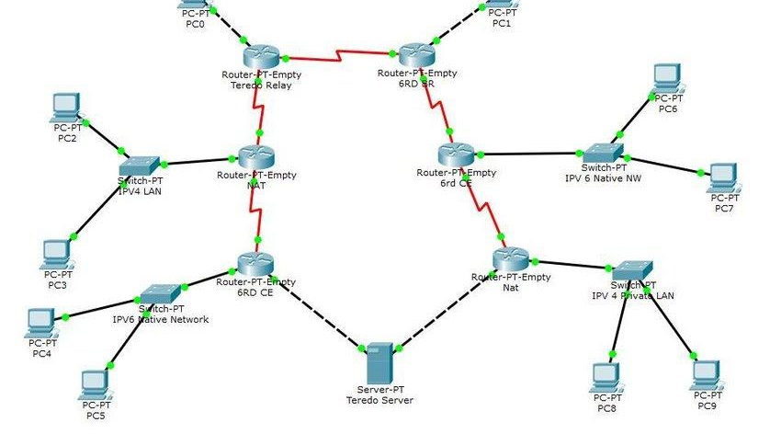



Different types of topology

Slide 52
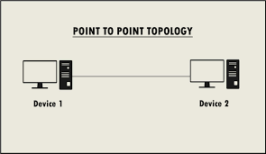
The point-to-point topology is the most basic of all network topologies. The network is made up of a direct connection between two computers. Because there is a direct connection, this is faster and more reliable than other types of connections. The disadvantage is that it can only be used in small areas with a high concentration of computers.

Slide 53
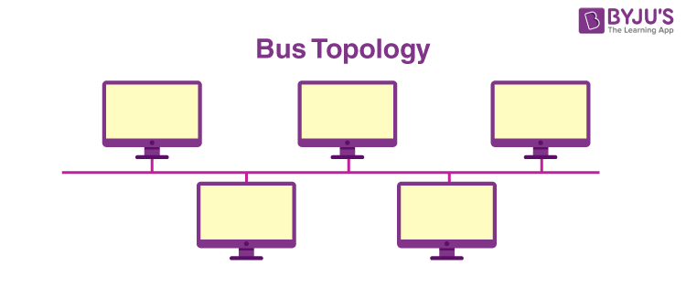
The bus topology makes use of a single main connection to which all nodes are directly attached. The primary cable serves as the network's backbone. Typically, one of the computers in the network serves as the computer server. The primary advantage of bus topology is the ease with which a computer or peripheral device can be connected. The second benefit is that the cable requirements are minimal, resulting in decreased costs.One disadvantage is that if the main cable fails, the entire network fails. This network type is also tough to debug. For these reasons, this topology is not appropriate for big networks, such as those that cover an entire building.

Slide 54
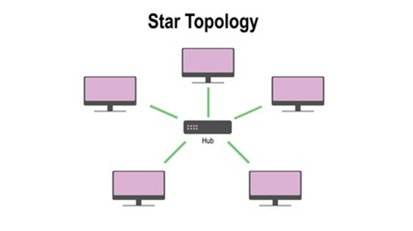
Each computer in a star topology is linked to a central hub via a point-to-point connection. The central hub can be a computer server that maintains the network, or it can be a much simpler device that merely allows PCs to join over the network. Because of the inexpensive initial costs, star topology is particularly common. It is also simple to add new network nodes. The network is robust in the sense that if one link between a computer and the hub breaks, the others remain operational. However, if the central hub fails, the entire network goes down. It also necessitates more cable than bus topology, making it more expensive.

Slide 55
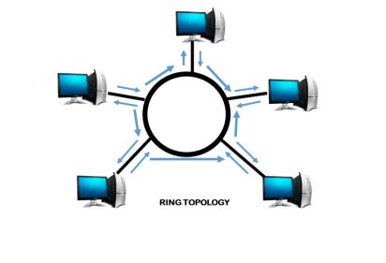
The computers in the network are connected in a circular form in ring topology, and data travels in only one direction. Each computer is directly connected to the next, establishing a single network conduit for signals. This network is simple to set up and maintain.If there is an issue with the network, it is simple to determine which link is faulty. It is particularly useful for handling high-volume traffic over long distances because each computer may act as a signal amplifier. On the negative side, adding computers to this form of network is more difficult, and if one computer fails, the entire network fails.

Slide 56
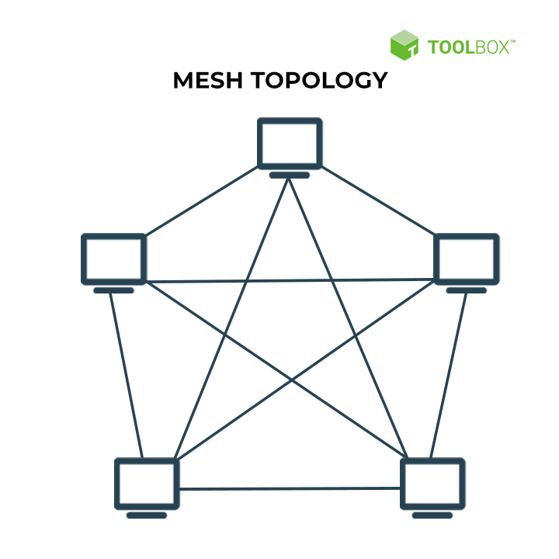
Every node in a mesh architecture is connected to every other node directly, point to point. All connections are direct, allowing the network to handle extremely high traffic volumes. It is also reliable since even if one connection breaks, the others continue to function. Since data is transmitted through a dedicated link, security is also quite high.

Slide 57
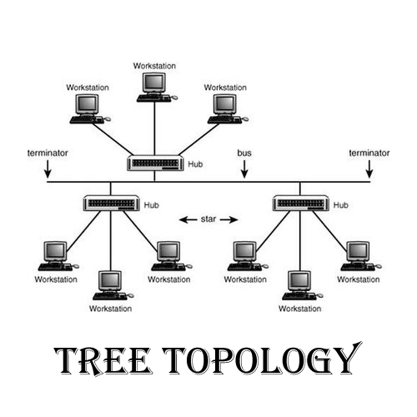
Tree topology is a network architecture that looks like a tree. There is one central node (the "trunk") in a tree topology, and each node is connected to it via a single path. Nodes might be compared to branches growing from the trunk.

Slide 58
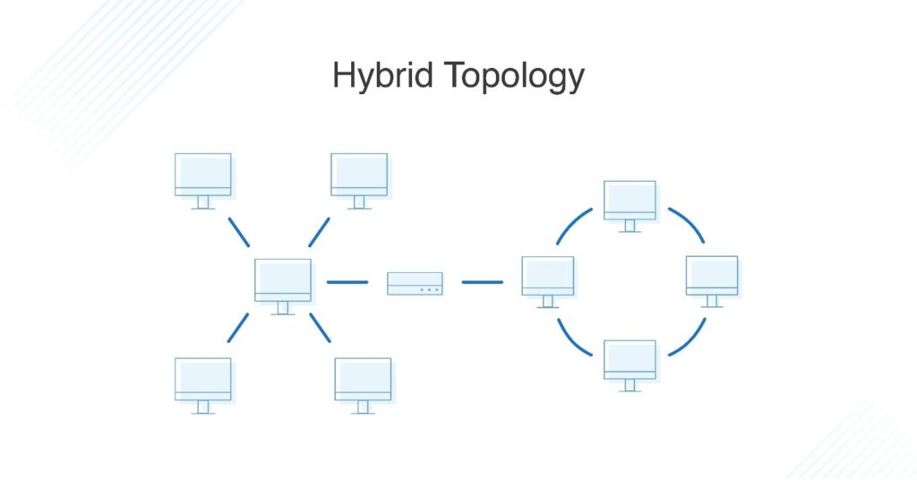
Hybrid topology is an integration of two or more different topologies to form a resultant topology which has many advantages (as well as disadvantages) of all the constituent basic topologies rather than having characteristics of one specific topology.

Slide 59
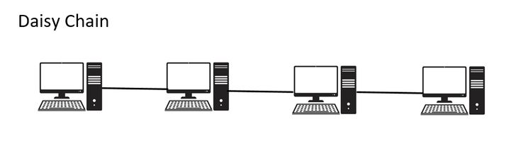
A daisy chain is a network topology that directs how network nodes, often computers, are linked. Different network topologies enable goals such as usability, persistence, and fault tolerant design.

Slide 60

Software is a collection of instructions, data, or computer programs that are used to run machines and carry out particular activities. It is the antithesis of hardware, which refers to a computer's external components. A device's running programs, scripts, and applications are collectively referred to as "software" in this context. It can be compared to the variable component of a computer, whereas the invariable component is the hardware.
COMPUTER SOFTWARE

Slide 61
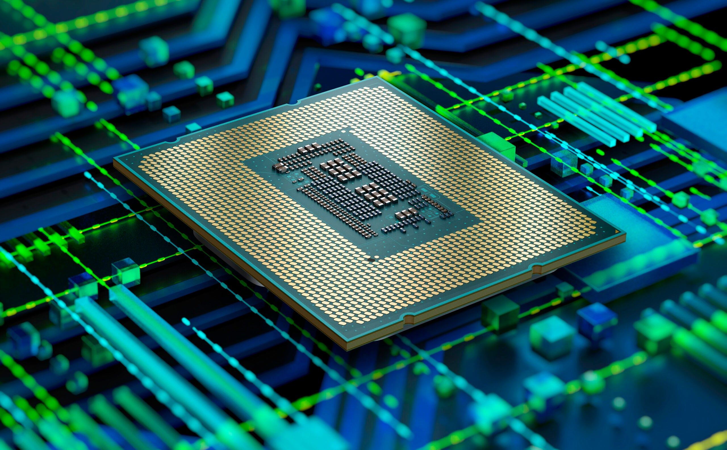
The central processing unit (CPU) of a computer is the component that retrieves and executes instructions. A CAD system's CPU is essentially its brain. It is made up of an arithmetic and logic unit (ALU), a control unit, and a number of registers.
CPU – Central Processing Unit

Slide 62
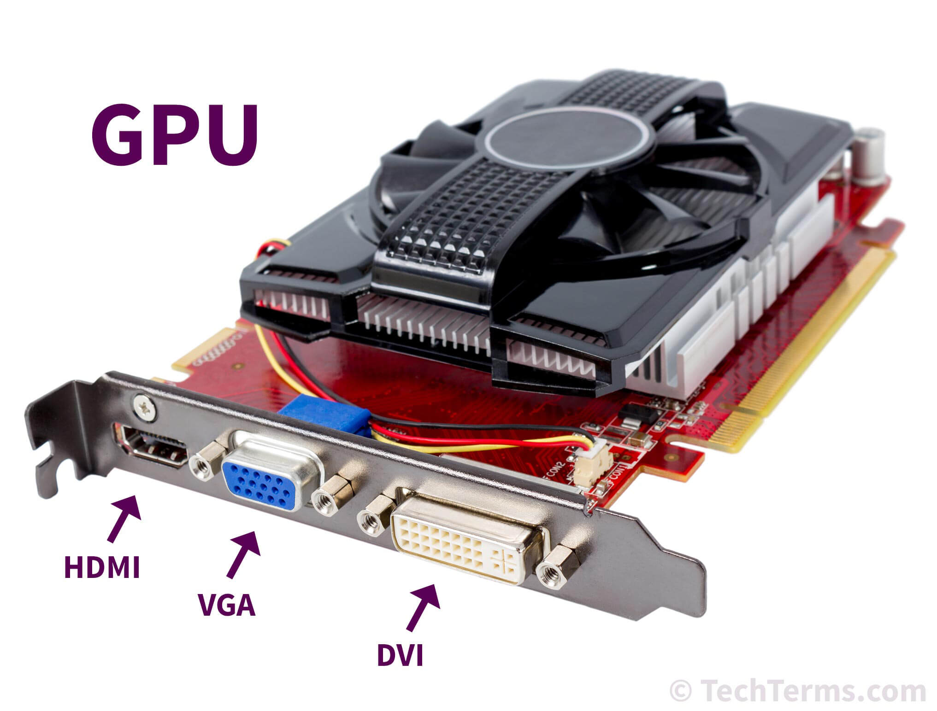
The graphics processing unit, or GPU, has emerged as one of the most important types of computing technology for both personal and business use. The GPU, which is designed for parallel processing, is used in a variety of applications, including graphics and video rendering. Although they are best known for their gaming capabilities, GPUs are increasingly being used in creative production and artificial intelligence (AI).
GPU – Graphic Processing Unit

Slide 63
Cross-layer functions
Cross-layer functions are services that are not bound to a specific layer but may affect multiple layers. Management and security are two orthogonal aspects that involve all layers. These services aim to improve the CIA triad of transmitted data confidentiality, integrity, and availability. In practice, cross-layer functions are the norm, as the availability of a communication service is determined by the interaction of network design and network management protocols.

Slide 64
Specific examples of cross-layer functions include the following:

Slide 65
Security service (telecommunication)^{[34]} as defined by ITU-T X.800 recommendation.
Management functions, i.e. functions that permit to configure, instantiate, monitor, terminate the communications of two or more entities: there is a specific application-layer protocol, common management information protocol (CMIP) and its corresponding service, common management information service (CMIS), they need to interact with every layer in order to deal with their instances.
Multiprotocol Label Switching (MPLS), ATM, and X.25 are 3a protocols. OSI subdivides the Network Layer into three sublayers: 3a) Subnetwork Access, 3b) Subnetwork Dependent Convergence and 3c) Subnetwork Independent Convergence.^{[35]} It was designed to provide a unified data-carrying service for both circuit-based clients and packet-switching clients which provide a datagram-based service model. It can be used to carry many different kinds of traffic, including IP packets, as well as native ATM, SONET, and Ethernet frames. Sometimes one sees reference to a Layer 2.5.
Cross MAC and PHY Scheduling is essential in wireless networks because of the time-varying nature of wireless channels. By scheduling packet transmission only in favourable channel conditions, which requires the MAC layer to obtain channel state information from the PHY layer, network throughput can be significantly improved and energy waste can be avoided.[

Slide 66
Programming interfaces
Solaris offers many kinds of "interfaces", such as the programming interface, elements of the user interface, protocols, and rules about naming and the locations of objects in the file system. One of the most important interfaces to the system is the programming interface -- the one offered to developers. The programming interface has two major parts: one seen by developers of applications, which is the API, and one seen by developers of system components, such as device drivers and platform support modules, which is the SPI (system programming interface).
Each programming interface to Solaris is also "visible" to the developer at two levels: source level and binary. When you see the acronyms API and SPI, this indicates the source level programming interface to the system. The terms Application Binary Interface (ABI) and System Binary Interface (SBI) indicate the binary interfaces corresponding to the respective source level programming interfaces. (Because the phrase "the ABI" can be confused with other binary interfaces, the "Solaris ABI" is refered to only by name.)

Slide 67
Transmission Control Protocol
The Transmission Control Protocol (TCP) is a key protocol in the Internet protocol suite. It arose from the initial network implementation, where it supplemented the Internet Protocol (IP). As a result, the entire suite is commonly known as TCP/IP. TCP delivers a stream of octets (bytes) between applications running on hosts connected by an IP network in a reliable, ordered, and error-checked manner. TCP, which is part of the TCP/IP suite, is used by major internet applications such as the World Wide Web, email, remote administration, and file transfer. SSL/TLS is frequently used on top of TCP.

Slide 68
Network Function
The Transmission Control Protocol is a communication protocol that sits between an application program and the Internet Protocol. It offers host-to-host connection at the Internet model's transport layer. An application does not need to understand the specific procedures for delivering data across a link to another host, such as the required IP fragmentation to accommodate the transmission medium's maximum transmission unit. TCP handles all handshaking and transmission details at the transport layer and provides an abstraction of the network connection to the application, often via a network socket interface. TCP is widely used by many internet applications, including the World Wide Web (WWW), email, FTP, Secure Shell, peer-to-peer file sharing, and streaming media.

Slide 69
Network Function
TCP is a reliable byte stream delivery service which guarantees that all bytes received will be identical and in the same order as those sent. Since packet transfer by many networks is not reliable, TCP achieves this using a technique known as positive acknowledgement with re-transmission. This requires the receiver to respond with an acknowledgement message as it receives the data. The sender keeps a record of each packet it sends and maintains a timer from when the packet was sent. The sender re-transmits a packet if the timer expires before receiving the acknowledgement. The timer is needed in case a packet gets lost or corrupted while IP handles actual delivery of the data, TCP keeps track of segments - the individual units of data transmission that a message is divided into for efficient routing through the network. For example, when an HTML file is sent from a web server, the TCP software layer of that server divides the file into segments and forwards them individually to the internet layer in the network stack. The internet layer software encapsulates each TCP segment into an IP packet by adding a header that includes (among other data) the destination IP address. When the client program on the destination computer receives them, the TCP software in the transport layer re-assembles the segments and ensures they are correctly ordered and error-free as it streams the file contents to the receiving application.

Slide 70
TCP segment structure
TCP packet appears in both informal and formal usage, whereas segment refers to the TCP protocol data unit (PDU), datagram[8]: 5-6 to the IP PDU, and frame to the data link layer PDU:Processes send data by using TCP and passing data buffers as arguments. TCP segments the data from these buffers and requests that the internet module [e.g., IP] send each segment to the destination TCP.

Slide 71
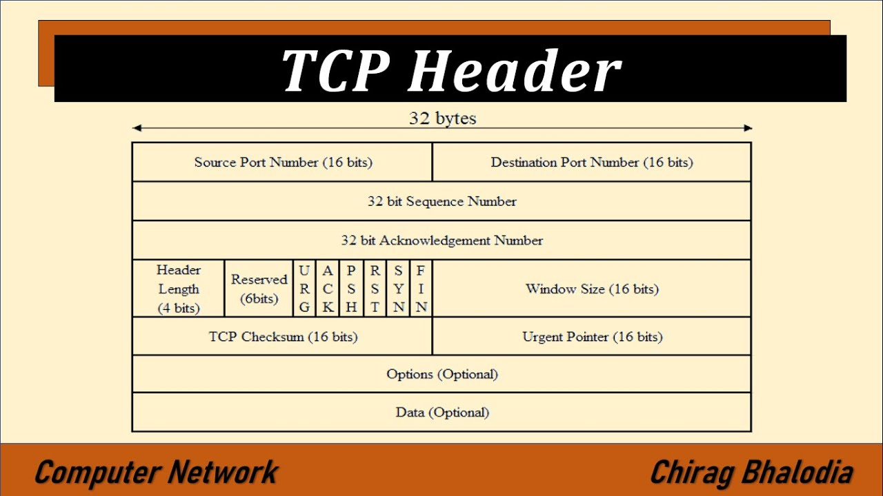
TCP segment header
The TCP header in the Transmission Control Protocol segment can range from 20 to 60 bytes. The acronym of TCP is Transmission Control Protocol. It is a protocol, practice, and regulations that control online communication between computers. The TCP(Transmission Control Protocol) has two protocols: TCP and UDP. In TCP, UDP headers are limited to 8 bytes in size, while the TCP Header is larger at 20 bytes with an option for additional data.

Slide 72
Protocol operation
The TCP protocol can be divided into three phases. Connection establishment is a multi-step handshake process that creates a connection before proceeding to the data transfer phase. The connection termination closes the connection and releases all allocated resources once the data transfer is complete.An operating system manages a TCP connection via the Internet socket, which represents the local end-point for communications. The local end-point goes through a series of state changes during the lifetime of a TCP connection:

Slide 73
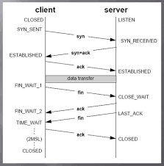
TCP socket states
A connection progresses through a series of states during its lifetime. The states are: LISTEN, SYN-SENT, SYNRECEIVED, ESTABLISHED, FIN-WAIT-1, FIN-WAIT-2, CLOSE-WAIT, CLOSING, LAST-ACK, TIME-WAIT, and the fictional state CLOSED. CLOSED is fictional because it represents the state when there is no TCB, and therefore, no connection. Briefly the meanings of the states are:

Slide 74
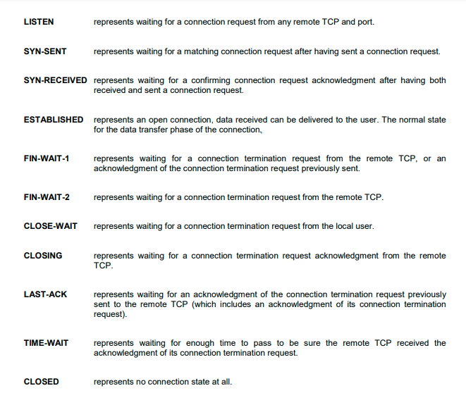
TCP socket states

Slide 75
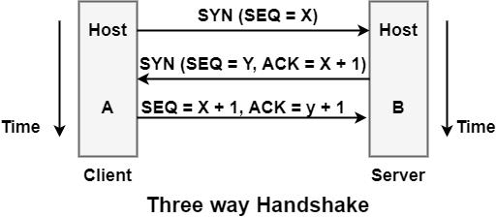
TCP segment header
Connection establishment is performed by using the three-way handshake mechanism. A three-way handshake synchronizes both ends of a network by allowing both parties to agree on unique sequence numbers.This mechanism also ensures that both sides are prepared to send data and learn when the other side is ready to communicate. This is necessary to avoid packet sharing or retransmission during session establishment or after session termination. Each host chooses a sequence number at random to track bytes in the stream it is sending and receiving.

Slide 76
TCP Connection Establishment
Connection establishment is performed by using the three-way handshake mechanism. A three-way handshake synchronizes both ends of a network by allowing both parties to agree on unique sequence numbers.This mechanism also ensures that both sides are prepared to send data and learn when the other side is ready to communicate. This is necessary to avoid packet sharing or retransmission during session establishment or after session termination. Each host chooses a sequence number at random to track bytes in the stream it is sending and receiving.

Slide 77
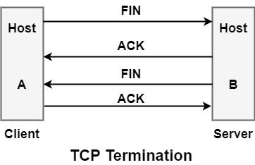
Connection termination
While establishing a connection requires three segments, terminating a connection requires four segments. When a TCP connection is full-duplex (data flows in each way independently of the other), each direction should be shut down separately.The graphic depicts the termination procedure for each host. When either end has done sending data, the rule is that they can share a FIN.When a TCP receives a FIN, it should notify the application that the data flow direction has been terminated at the other end. A FIN is typically sent as a result of the application issuing a close.

Slide 78
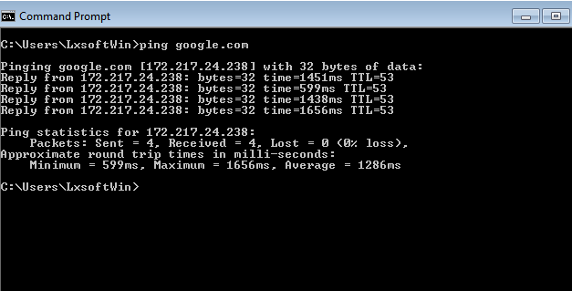
Networking Commands

Slide 79
Networking commands
The network infrastructure is a very intricate system of cables, routers, access points, data packets, and countless other tiny parts that work together to ensure that the entire network operates without a hitch. The network infrastructure could completely collapse if any of these smaller parts experience a problem. This could result in a breakdown of the wired (ethernet), wireless (WiFi), and mobile infrastructure. This is why it's crucial to have access to network performance statistics and be familiar with troubleshooting procedures, including networking commands that can be used at the command prompt to get network information. It might also include anything from the system's IP address to the server's IP address, which is where a website or URL is housed. An intermediary platform between the user and the underlying network infrastructure is the operating system. To use the commands listed below on the Windows operating system, select "Start," then "Run," and then type "cmd." The command prompt will open as a result. You can make use of the terminal program in Mac OS.

Slide 80
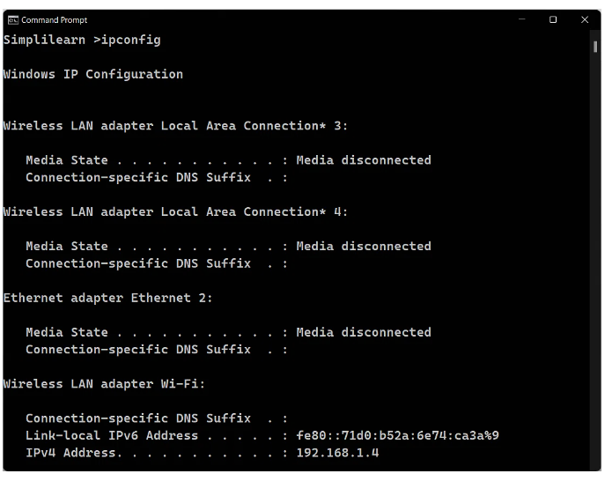
IPConfig
This ipconfig command is used for finding the IP address and default gateway of your network. An IP address is the address (unique identifier) of your device in a network. This is the first step of network troubleshooting. Without an IP address, one would not know where to start looking. To see how this command works, open the command prompt window and type ipconfig and press Enter key. The IP address, subnet mask, and default gateway will be displayed as shown in this figure appearing here. This only works with the command line tool.

Slide 81
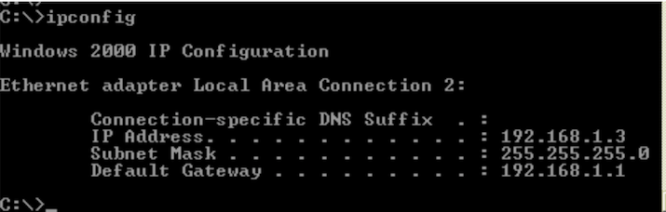
NSLOOKUP
The NSLOOKUP command is used in the system to troubleshoot network connectivity issues. We can use the nslookup command to get information about our system's DNS server, such as the domain name and IP address.nslookup command to enter in Prompt

Slide 82
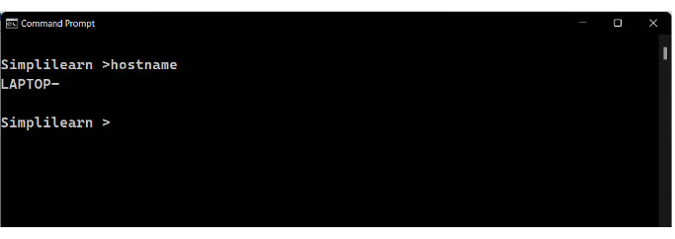
HOSTNAME
The hostname command displays the system's hostname. The hostname command is considerably easier to use than searching for it in the system settings. Prompt command to enter - hostname

Slide 83
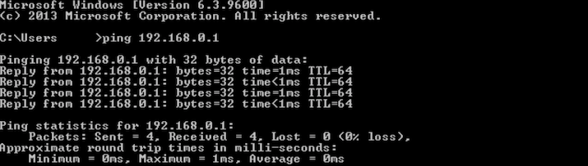
ping
The ping command is typically used for checking the network connectivity from your system to an end device like a server or a printer and also of a website. This command is used while troubleshooting the entire network. So, when you enter a URL in your web browser, what you're actually doing is instructing your machine to connect to the website name. The website name is actually an alias for the IP address. So this command can be used in two ways:
It can be used to ping a network IP address.
It can be used to ping a website or hostname directly.

Slide 84
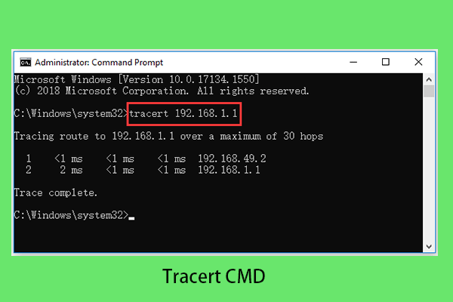
tracert
The TRACERT command is used to trace the route of a data packet during transmission to the destination host. It also gives us with the "hop" count during transmission.We can troubleshoot network issues and determine the source of the problem during data packet transfer by using the number of hops and the hop IP address.

Slide 85
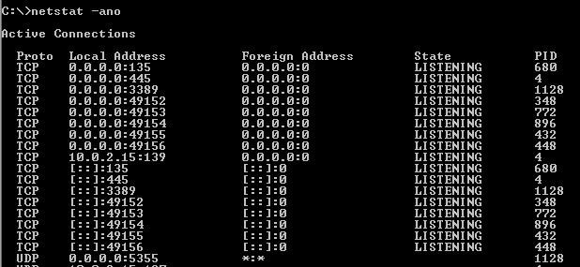
NETSTAT
The network statistics (netstat) command is a networking tool for troubleshooting and configuration that may also be used to monitor network connections. This command is commonly used for incoming and outgoing connections, routing tables, port listening, and use statistics. Let's look at some of the most common and basic uses for netstat.

Slide 86

ARP(Address Resolution Protocol)
The Address Resolution Protocol (ARP) is a layer 2 protocol that is used to convert MAC addresses to IP addresses. All hosts on a network are identified by their IP address, although NICs have MAC addresses rather than IP addresses. ARP is the protocol that connects an IP address to a MAC address.When a host wants to send a packet to another host on its local area network (LAN), say IP address 10.5.5.1, it first sends out (broadcasts) an ARP packet. The ARP packet includes a basic question: What is the MAC address associated with IP address 10.5.5.1? The host that has the IP address configured responds with an ARP message with its MAC address.

Slide 87

SYSTEM INFO
System Information provides detailed configuration data for a machine and its operating system, such as operating system configuration, security information, product ID, and hardware properties (such as RAM, disk space, and network cards).

Slide 88

traceroute
One of the most helpful networking commands in Linux is traceroute. It is used for network troubleshooting. It senses the delay and determines the best path to your destination. It mostly aids in the following ways:
It labels and identifies all of the devices on the path.
It takes the path to the destination. It determines and reports the source of network lag.

Slide 89

tracepath
The tracepath command is used to trace the path from the origin to the destination. Each line in the tracepath output represents a router (hop) that the packet passes through.

Slide 90

Ss command
The ss (socket statistics) program displays network information via a CLI command. The ss command is a simplified and speedier replacement for the now-defunct netstat command. ss, in conjunction with the ip command, is critical for acquiring network information and troubleshooting network issues.

Slide 91

dig command
The dig command (domain information groper) is a versatile tool for querying DNS name servers. It does DNS lookups and displays the results supplied by the name server queried (s). Because of its flexibility, ease of use, and clarity of output, most DNS administrators employ the dig command to troubleshoot DNS problems. Although dig is typically used with command-line inputs, it also includes a batch mode that allows it to read lookup requests from a file. Unlike previous versions, the BIND9 implementation of dig supports multiple lookups from the command line.

Slide 92
Internet protocol

Slide 93

Internet protocol
Internet Protocol (IP) is the method or protocol by which data is sent from one computer to another on the internet. Every computer on the internet, referred to as a host, has at least one IP address that distinguishes it from every other computer there. The core set of protocols that make up the contemporary internet is IP. A Protocol for Packet Network Intercommunication, a paper by Vinton Cerf and Robert Kahn that was published by the Institute of Electrical and Electronics Engineers in May 1974, is where it was first described. Additional transport protocols that permit actual communication between multiple sites are at the heart of what is often referred to as IP. The Transmission Control Protocol (TCP) is one of the main protocols that operates on top of IP, which is why IP is also known as TCP/IP. TCP, however, is not the sole protocol included in IP.

Slide 94
Function
Addressing host interfaces, encapsulating data into datagrams (including fragmentation and reassembly), and routing datagrams from a source host interface to a destination host interface across one or more IP networks are all responsibilities of the Internet Protocol. [2] The Internet Protocol defines the format of packets and offers an addressing mechanism for these purposes. datagram is made up of two parts: a header and a payload. The IP header contains the source IP address, the destination IP address, and any additional metadata required to route and transmit the datagram. The data that is transported is referred to as the payload. Encapsulation refers to the process of enclosing the data payload into a packet with a header.

Slide 95
Reliability
The design of the Internet protocol suite adheres to the end-to-end principle, a concept adapted from the CYCLADES project. Under the end-to-end principle, the network infrastructure is considered inherently unreliable at any single network element or transmission medium and is dynamic in terms of the availability of links and nodes. No central monitoring or performance measurement facility exists that tracks or maintains the state of the network. For the benefit of reducing network complexity, the intelligence in the network is purposely located in the end nodes.[

Slide 96
Link capacity and capability
There is no certainty that any specific path will actually be able to conduct the desired data transmission due to the dynamic nature of the Internet and the diversity of its components. The maximum size of data packets that can be sent over a given network is one of the technical limitations. Path MTU Discovery can be utilized for the full anticipated path to the destination, and facilities are available to evaluate the local link's maximum transmission unit size.When the link MTU is surpassed, the IPv4 internetworking layer automatically splits a datagram into smaller pieces for transmission. When fragments are received out of order, IP offers reordering. While an IPv6 network does not undertake network element fragmentation, it does require end hosts and higher-layer protocols to prevent going beyond the path.

Slide 97
Internet Protocol: Network Layer
In networking, a protocol is a standardized way of doing certain actions and formatting data so that two or more devices are able to communicate with and understand each other.
Consider the procedure of mailing a letter to understand why protocols are required. Addresses are written on the envelope in the following order: name, street address, city, state, and zip code. The post office will not deliver an envelope that has the zip code put first, followed by the street address, followed by the state, and so on. In order for the postal system to function, there is an agreed-upon procedure for writing addresses. Similarly, all IP data packets must contain certain information in a specific order, and all IP addresses must adhere to a specified format.

Slide 98


Slide 99
What is an IP address? How does IP addressing work?
A unique identifier provided to a device or domain that connects to the Internet is known as an IP address. Each IP address is a string of numbers and letters, such as '192.168.1.1'. Users can access websites without remembering this complex string of letters thanks to DNS resolvers, which convert human-readable domain names into IP addresses. Each IP packet will include both the IP address of the device or domain delivering the packet and the IP address of the intended recipient, similar to how a piece of mail includes both the destination and return address.

Slide 100
Internet Protocol: Network Layer
In networking, a protocol is a standardized way of doing certain actions and formatting data so that two or more devices are able to communicate with and understand each other.
Consider the procedure of mailing a letter to understand why protocols are required. Addresses are written on the envelope in the following order: name, street address, city, state, and zip code. The post office will not deliver an envelope that has the zip code put first, followed by the street address, followed by the state, and so on. In order for the postal system to function, there is an agreed-upon procedure for writing addresses. Similarly, all IP data packets must contain certain information in a specific order, and all IP addresses must adhere to a specified format.

Slide 101
Thanks!
Does anyone have any questions?
Message me:
angelamae.pologon@gmail.com

